Slide 1
EE 669 VLSI Technology Assignment 1: To study the Zinc Blend lattice using VESTA
Kartik Chikkanagoudar
21D170023

Slide 2
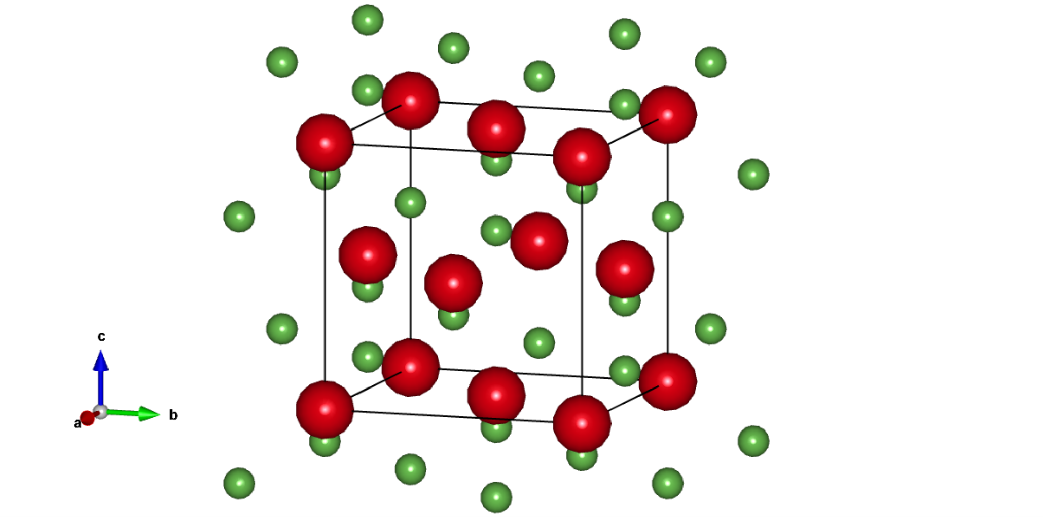
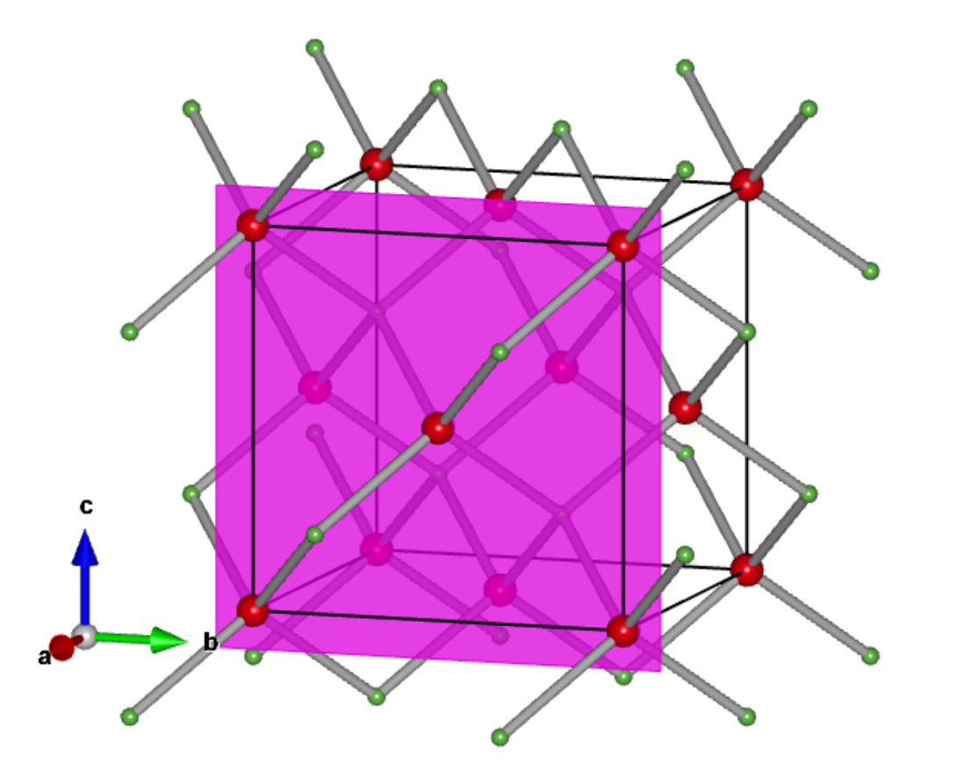
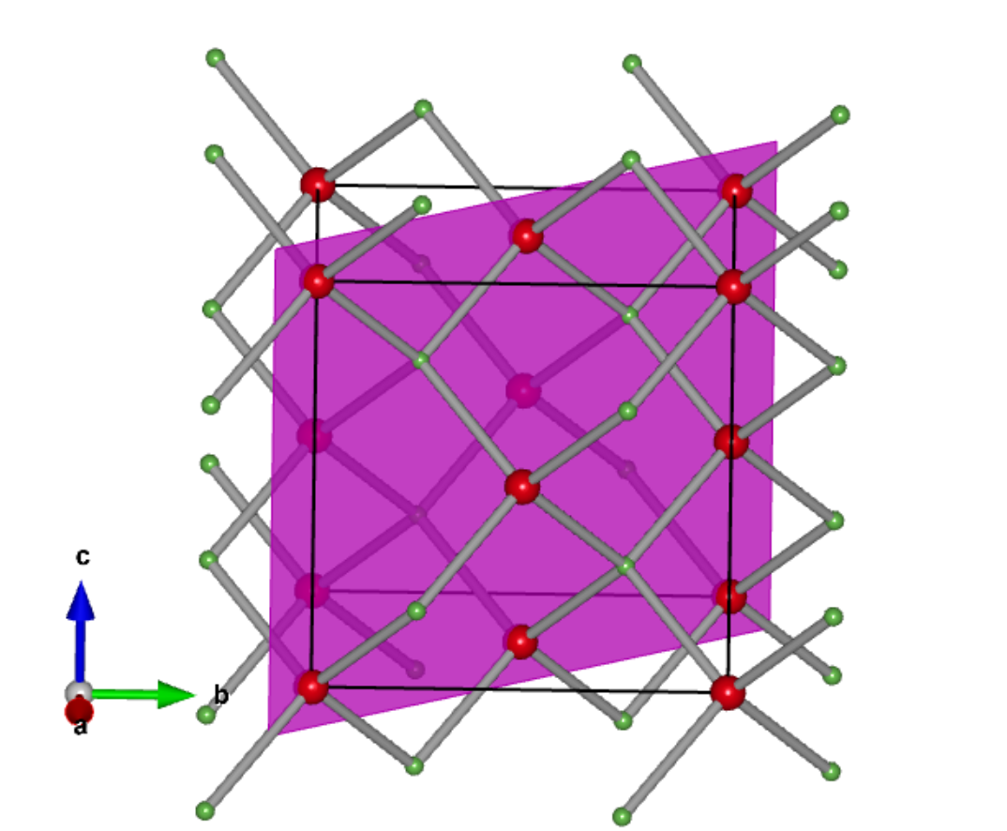
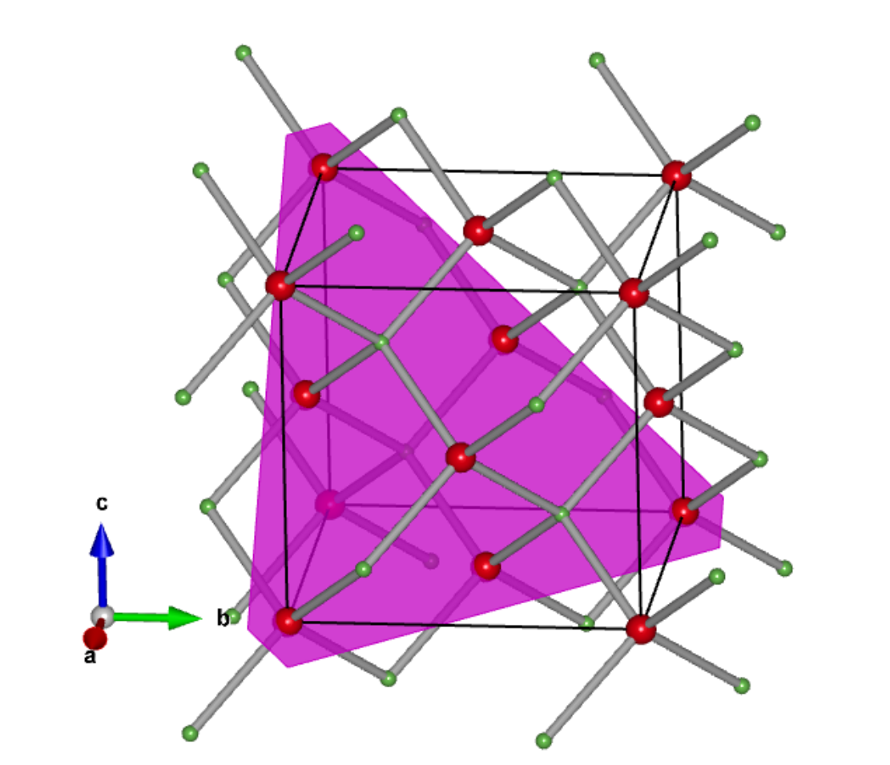
Q1 : 3D images of plane views in the crystal
(100) PLANE
(110) PLANE
(111) PLANE

Slide 3
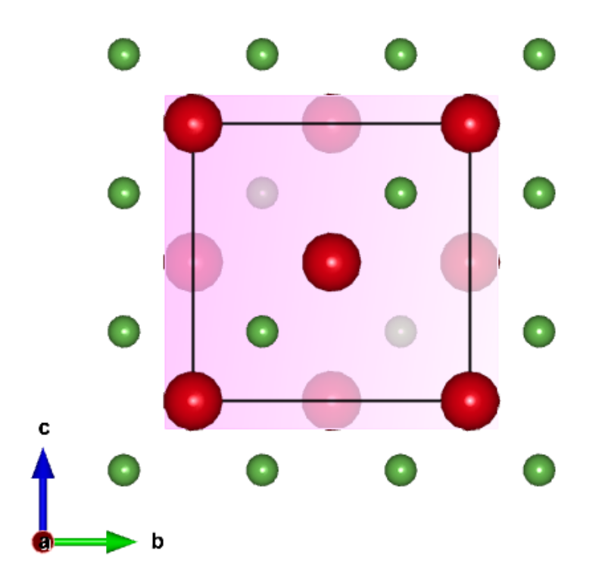
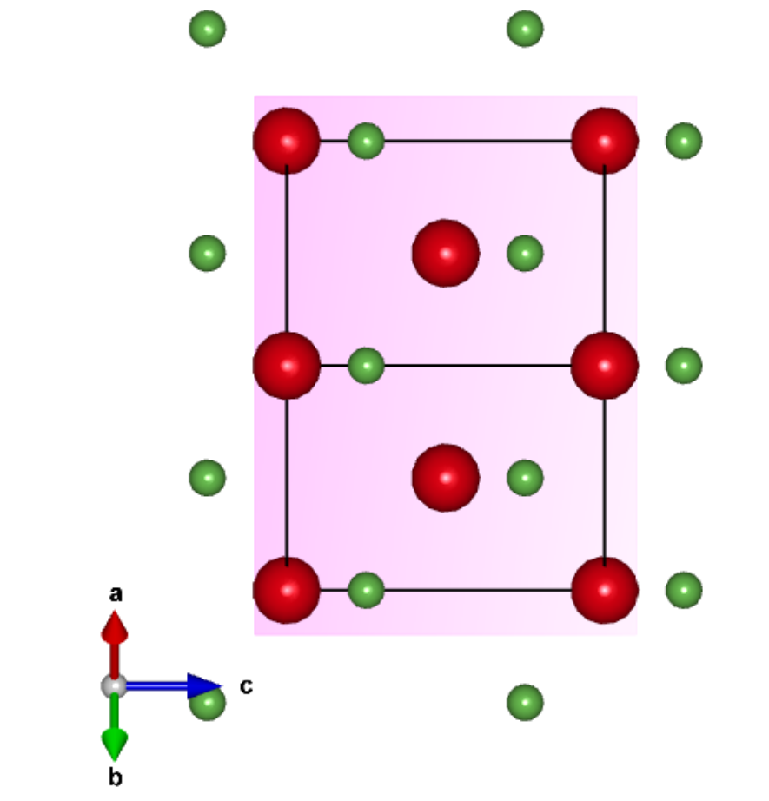
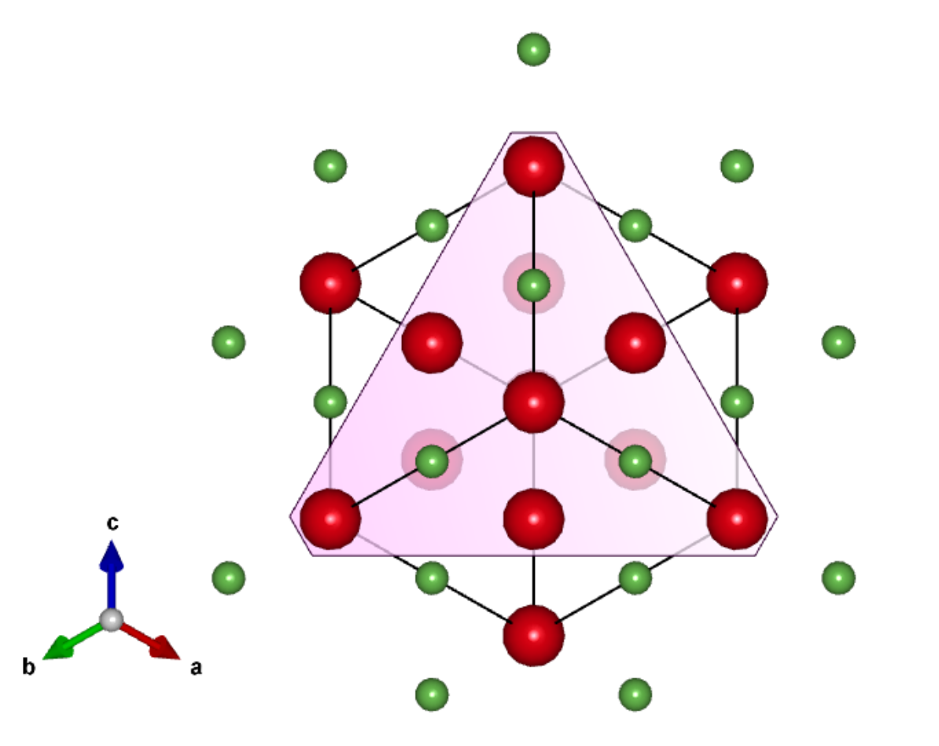
Q1 : Comparing different plane views in the crystal
(100) PLANE ALONG [100] DIRECTION
(111) PLANE ALONG [111] DIRECTION
(110) PLANE ALONG [110] DIRECTION
Observation :
There are a different number of atoms in each plane per unit cell and therefore their arial densities are different.
The spacing of atoms and structure of atoms are different along the different planes, therefore they have different periodic potential along the planes.
The (100) and (111) planes have only Ga atoms in plane whereas the (110) plane has both Ga and As atoms in plane.

Slide 4
Q2 : Comparing Arial densities of atoms in the plane
(100) PLANE ALONG [100] DIRECTION
(110) PLANE ALONG [110] DIRECTION
(111) PLANE ALONG [111] DIRECTION
Arial density = 2/[(5.65e-8)^2]
= 6.26e14 atoms/cm2
Arial density = 4/[(5.65e-8)^2 * √2 ]
= 8.86e14 atoms/cm2
Arial density = 2/[(5.65e-8 * √2)^2 * (√3/4)]
= 7.24e14 atoms/cm2
Observation :
Arial densities are not equal and it is maximum along the 110 plane and minimum along the 100 plane.
Arial densities along different planes is different implies that GaAs has anisotropy since electron encounter different amount of scattering along different directions.

